Slide 1
Software Engineering :
8 : Software Architecture Part 1
Professor Imed Bouchrika National School of Artificial Intelligence imed.bouchrika@ensia.edu.dz

Slide 2
Outline :
Part 1:
Introduction to Software Architecture
Software Architecture Process
Selecting Technological Stack
Architecture Quality Attributes
Software Architectural Styles
Part 2 :
Programming Questions
Design Patterns
Architecture Principles : SOLID
Part 3 :
Decoupling & Cohesion
Documenting the Architecture
Case Study

Slide 3
Introduction to Software Architecture
What’s Software Architecture :
It is the process to design and define the functional structure of a software system via:
Identifying the different components, elements and subsystems composing the whole software.
Defining the behaviour of the software components in addition to their interfaces.
It is a process focused on the structure not on the code and implementation details.

Slide 4
Introduction to Software Architecture
What’s Software Architecture :
It is the link between the requirements engineering phase and design phase where specifications are analysed and turned into a document designing the high-level structuring and behaviour of the system in order to produce low-level designs ( Including UI, database, class diagram…)

Slide 5
Introduction to Software Architecture
Can we develop the To-Do App without Architectural Design :
Yes , we can start developing directly or using some framework
We conduct some UML modeling for the class, use case, sequence …(But this is not architectural design)
But : ?

Slide 6
Introduction to Software Architecture
Can we develop the To-Do App without Architectural Design :
Yes , we can start developing directly or using some framework
We conduct some UML modeling for the class, use case, sequence …(But this is not architectural design)
But : at what cost for the following questions ?
Can it Scale to support a large number of users ?
What happens if change the database engine to Oracle ? NoSQL ?
Can we integrate a native mobile application ?
Integrate other authentication-services including Google ( OAuth..) ?

Slide 7
Introduction to Software Architecture
Why Software Architecture is Important:
Provides a representation that facilitates communication and explanation among all stakeholders including developers of how requirements would be implemented.
Highlights early design decisions that will have a profound impact on all software engineering work that follows.
Constitutes a relatively small model/blueprint/prototype of how the system components are structured and work together

Slide 8
Introduction to Software Architecture
Why Software Architecture is Important:
Provides a representation that facilitates communication and explanation of complex requirements among all stakeholders including developers.
Highlights early design decisions that will have a profound impact on all software engineering work that follows.
Constitutes a relatively small model/blueprint of how the system components are structured and work together
Making good decisions while defining the software architecture is critical to the success of a software product

Slide 9
Introduction to Software Architecture
Who does the Software Architecture :
Software Architect :
Designs a functional system the qualities of being Fast, Secure, Reliable and Maintainable by selecting the optimal technology platforms and architectural patterns to achieve such goals.
Must be familiar with technological tools and concepts
Have a good understanding of specification requirements
Must have coding/programming skills. ? Why

Slide 10
Introduction to Software Architecture
Who does the Software Architecture :
Software Architect :
Designs a functional system the qualities of being Fast, Secure, Reliable and Maintainable by selecting the optimal technology platforms and architectural patterns to achieve such goals.
Must be familiar with technological tools and concepts
Have a good understanding of specification requirements
Must have coding/programming skills. ? Why
Because they can envision whether particular architecture is feasible to implement
not wait for the developers to tell and humiliate the architect after months of implementation that the architecture is not feasible to implement

Slide 11
Introduction to Software Architecture
How to be a Software Architect :
You need to start your career as a Software Developer
Have a lot of experience in developing different types of software products. * ( Estimated no less than 5 years )
Money wise ?

Slide 12
Software Architecture Process
Understand the Functional Requirements
01
Define the system goals.
List the functional use cases and what the system should do.

Slide 13
Software Architecture Process
Understand the Non-Functional Requirements
02
Define Technical and Service Level attributes. This includes:
#Users, Performance requirements, volume of data, network capability,,...
They are not always known to the business analyst or client

Slide 14
Software Architecture Process
Understand the Non-Functional Requirements
02
Non-functional requirements are more important to the architect than functional requirements as they impact heavily the structure of the software
Define Technical and Service Level attributes. This includes:
#Users, Performance requirements, volume of data,...
They are not always known to the business analyst or client

Slide 15
Software Architecture Process
Map the Components
03
Define the components, modules or subsystems that would constitute the software system.
Explain the goal, tasks and functionality of each component describing what they would accomplish.

Slide 16
Software Architecture Process
Select the Technological Stack
Software architects with developers would select :
What Platform/Programming Frameworks/Programming Language the system will be based including : backend(s), front-end(s), data stores and communication.
Tools Software /APIs/External Services the system would rely on.
04

Slide 17
Software Architecture Process
Select the Technological Stack
Software architects with developers would select :
What platform/Programming Frameworks/Programming Language the system will be based including, backend platform(s), front-end platforms and data stores.
Tools Software /APIs/External Services the system would rely on.
04
It is SUPER IMPORTANT ? WHY

Slide 18
Software Architecture Process
Select the Technological Stack
Because :
It is irreversible : A change in a technology framework or platform may require a complete re-implementation of the software + substantial delay + going over budget..
Emotional : Developers usually prefer to stick to some technologies they subjectively prefer even though it is inferior in terms of performance.
04

Slide 19
Software Architecture Process
Select the Technological Stack
What factors to consider when choosing the technology:
Can perform the task
Does it run on Mobile devices ?
Does it run across different platforms ?
Does it offer a library for GUIs ?
Does offer AI libraries to process data ?
Does it support storage of large data ?
Does it have a libraries for a specific hardware ?
04

Slide 20
Software Architecture Process
Select the Technological Stack
What factors to consider when choosing the technology:
Large Active Community and Support
Check StackOverflow, See recentness of questions, number of questions from the tags.
If you get stuck, at least, there is an active community to assist you or find solution to most common problems.
04

Slide 21
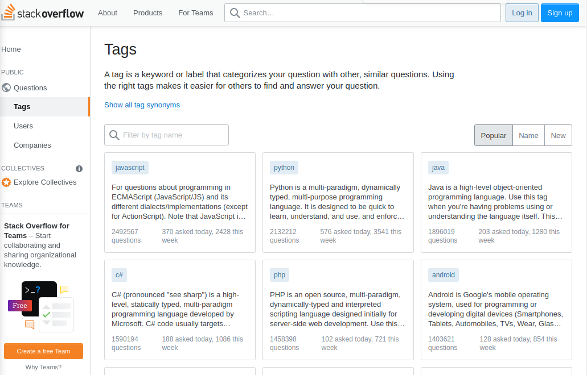
Software Architecture Process
Select the Technological Stack
What factors to consider when choosing the technology:
Large Active Community and Support
Check StackOverflow, See recentness of questions, number of questions from the tags.
04

Slide 22
Software Architecture Process
Select the Technological Stack
What factors to consider when choosing the technology:
Popularity : Even though it is superficial. It is important as it can give better insights on performance, portability and richness of features….
Google Trend can be used
04

Slide 23
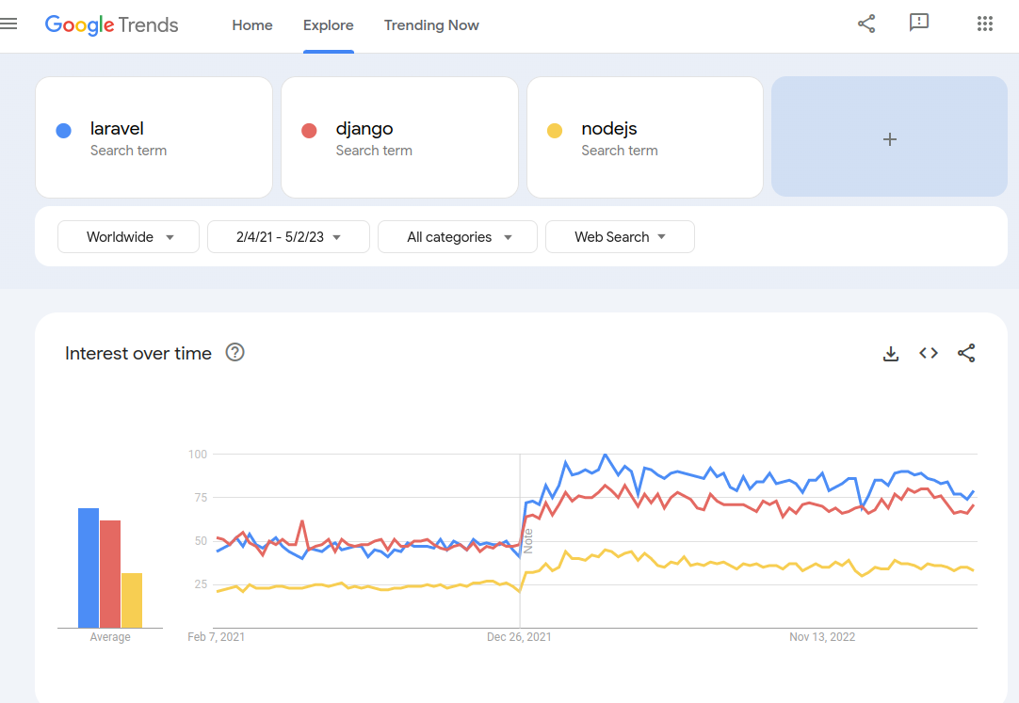
Software Architecture Process
Select the Technological Stack
What factors to consider when choosing the technology:
Popularity : Even though it is superficial. It is important as it can give better insights on performance, portability and features….
Google Trend can be used
04

Slide 24
Software Architecture Process
Select the Technological Stack
What factors to consider when choosing the technology:
Licensing and Cost
Maintenance and future upgrades
Documentation
Legal Issues and Regulations
04

Slide 25
Software Architecture Process
Select the Technological Stack
Backend Technology
Backend is :
The part of the software product that can be utilized by the system administrators or product owners/staff or other external systems to operate, manage and communicate with the software product.
Not meant to be accessed by the end-user.
04

Slide 26
Software Architecture Process
Select the Technological Stack
Backend Technology
We can develop as backend components:
Web Applications
Web APIs
Console-Based System
Services
04

Slide 27
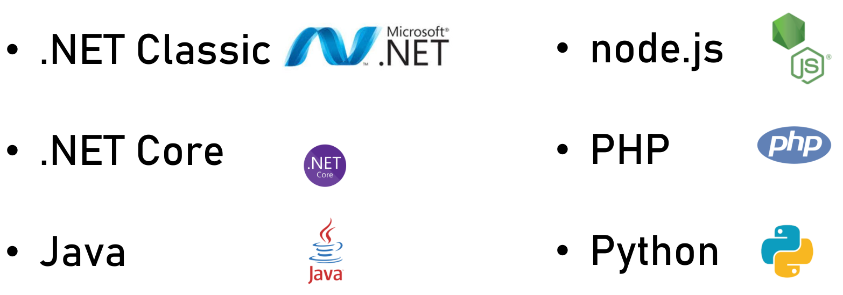
Software Architecture Process
Select the Technological Stack
Backend Technologies
04

Slide 28
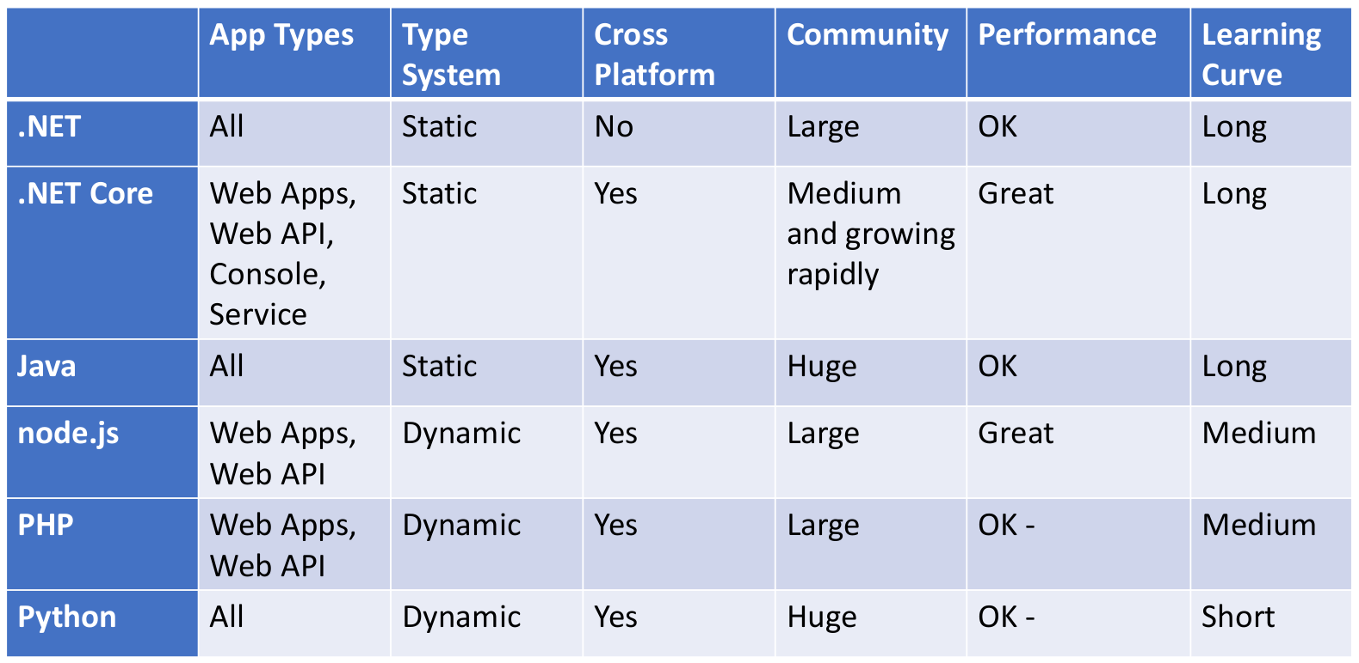
Software Architecture Process
Select the Technological Stack
Backend Technology
04

Slide 29
Software Architecture Process
Select the Technological Stack
Frontend Technology
Front-end Component is the user interface with which the human end-user interacts.
We can develop Front-end components for :
Web Applications
Desktop Applications
Mobile Applications
Console (Not now..)
04

Slide 30
Software Architecture Process
Select the Technological Stack
Frontend Technology
Web Applications:
HTML, CSS, JavaScript.
There are many frameworks to facilitate the development…
React, Angular, Bootstrap, Tailwind, JQuery,..
04

Slide 31
Software Architecture Process
Select the Technological Stack
Frontend Technology
Desktop Applications:
Always Look for a rich UI Toolkit
Tkinter
Electron
Swing, JavaFX,,,
QT
WinForms, WPF, UWP
wxWidget
..
04

Slide 32
Software Architecture Process
Select the Technological Stack
Data Storage Technology
Consider the requirements:
Types of transactions ? Need for ACID ?
Size and type of the data ?
Reliability requirement ?
Number of users accessing at the same time ?
Types of operation : read vs write ?
Number of operations per minute ?
Privacy Issue
…
04

Slide 33
Software Architecture Process
Select the Technological Stack
Data Storage Technology
Database
Relational SQL-Based DBMS :
Very mature and enforces a relational schema, but storing large amount of data, can impact the performance.
MySQL, PostgreSQL, ClickHouse, Oracle, SQLite, HSQLDB…
NoSQL : Stored as JSON, great emphasis on scale and performance. But, mostly schema-less, no support for transactions and querying can be frustrating. Example, MongoDB
XML File : Semi-structured text, can be queried using xPath or xQuery.
04

Slide 34
Software Architecture Process
Select the Technological Stack
Data Storage Technology
Files:
Local File System
Cloud Storage : S3
Amazon AWS S3, Azure, Google Cloud, Digital Ocean Spaces…
Database ?
CDN
Distributed Servers..
04

Slide 35
Software Architecture Process
Select the Technological Stack
Communication Technology
How objects, components, services or subsystems communicate ? What data format being used for the transfer of data ?
RPC ? RMI ? CORBA ? REST ? SOAP ? Message-Queue (Kafka , Redis …)?
04

Slide 36
Software Architecture Process
Design the Architecture
05
Based on
The functional requirements
Non-Functional requirements
Technological Stack
Architects would creatively propose a blueprint describing the structure and behavior of the components

Slide 37
Software Architecture Process
Write the Architecture Document
06
Architects produce an architectural document describing the high-level process to implement the software.
A good document is relevant for all levels in the organization including CEO, CTO and the development team.

Slide 38
Software Architecture Process
Support the Development Team
The job for the architect is not done once the software architectural document is done.
The architect needs to support the team to:
Make sure they are implementing according to the architecture.
Solve any dilemmas and re-adapt the architecture due to non-anticipated problems and issues.
07

Slide 39
Architecture Quality Attributes
Quality Attributes ( *-ilities)
Technical capabilities that should be used in order to implement and fulfill the non-functional requirements
They are closely tied to non-functional requirements
Example : Non-functional requirement statement :
“The to-do App must be implemented to work under heavy load due to many users accessing at the same time”
Quality Attribute or Technical capability : Scalability

Slide 40
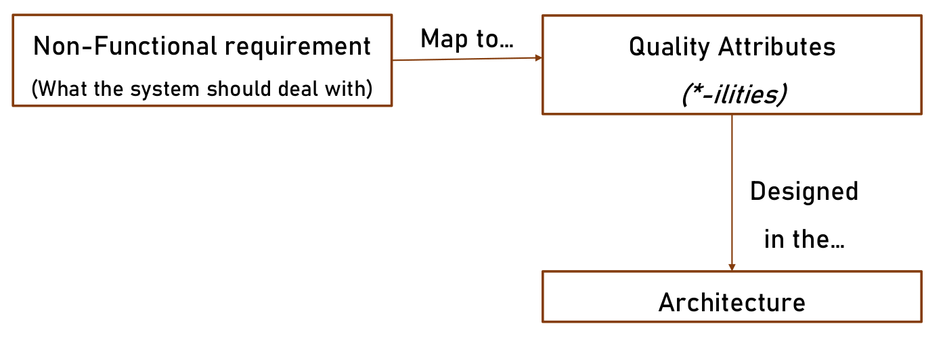
Architecture Quality Attributes
Quality Attributes ( *-ilities)

Slide 41
Architecture Quality Attributes
Importance of Non-Functional Requirements :
“The to-do App must be implemented to work under heavy load due to many users accessing at the same time”
Vs
“The to-do App must be implemented to work under heavy load due to many users accessing at the same time and not waste money on unused resources”

Slide 42
Architecture Quality Attributes
Importance of Non-Functional Requirements :
“The to-do App must be implemented to work under heavy load due to many users accessing at the same time”
Vs
“The to-do App must be implemented to work under heavy load due to many users accessing at the same time and not waste money on unused resources”
Totally different architectures

Slide 43
Architecture Quality Attributes
Scalability :
The system capacity to handle heavy load due to an increase of :
Number of users
Size of the data
Running or deployed instances.
Scale Up ( Vertical ) : Add more processors, RAM, Hard-drives…
Scale Out : Add more Machines, VMs to the pool of servers.

Slide 44
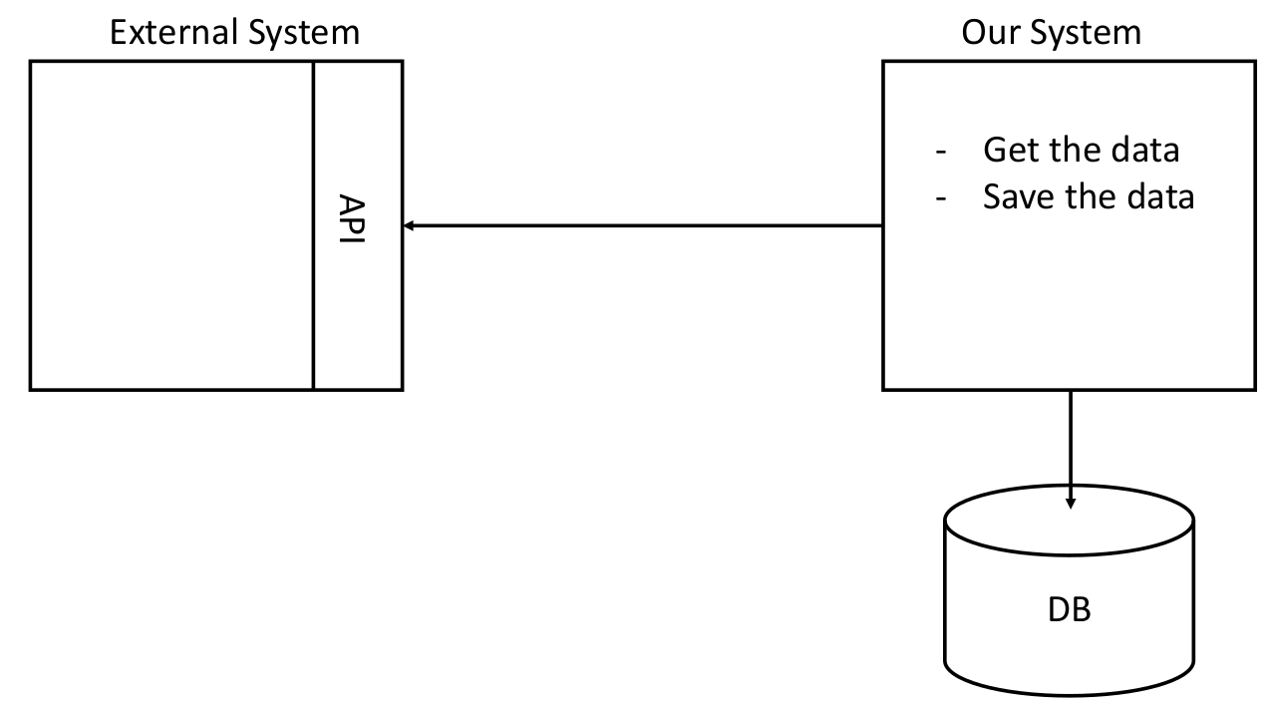
Architecture Quality Attributes
Modularity :
Modular system is built from (smaller) building blocks that can be changed or replaced or integrated without affecting the whole system.
Assume that the API has changed ?

Slide 45
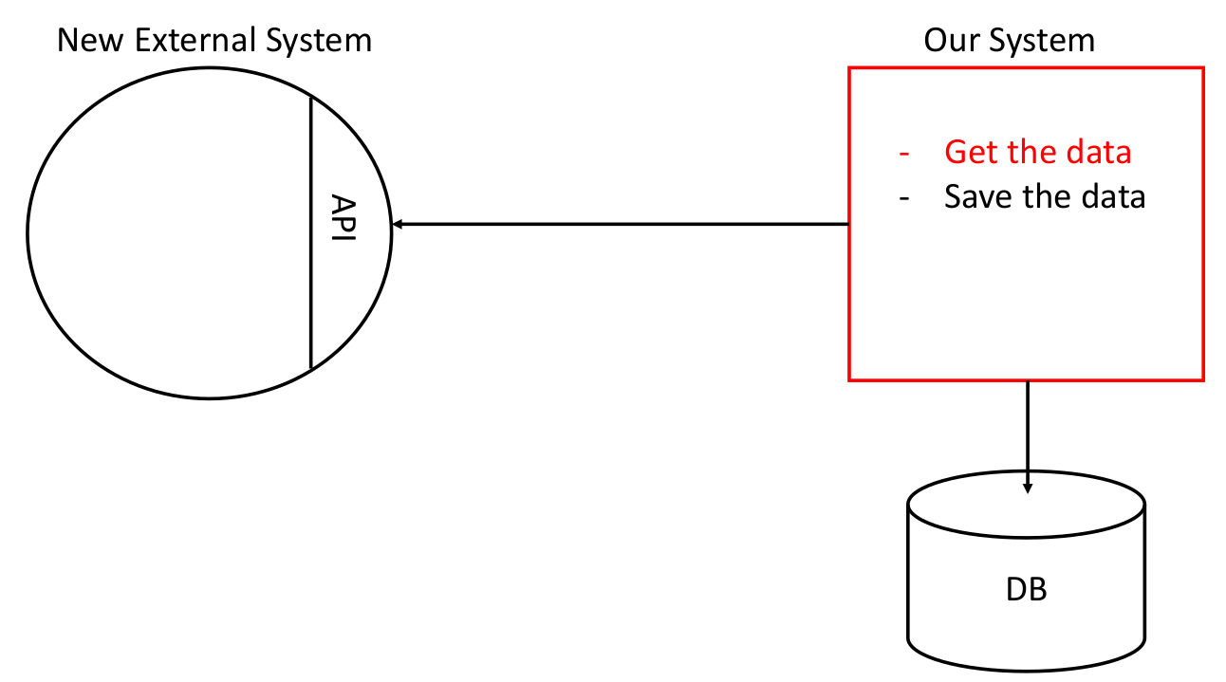
Architecture Quality Attributes
Modularity :
Modular system is built from (smaller) building blocks that can be changed or replaced or integrated without affecting the whole system.

Slide 46
Architecture Quality Attributes
Modularity :
Modular system is built from (smaller) building blocks that can be changed or replaced or integrated without affecting the whole system.
It requires modifying and testing the full system + FULL and long deployment

Slide 47
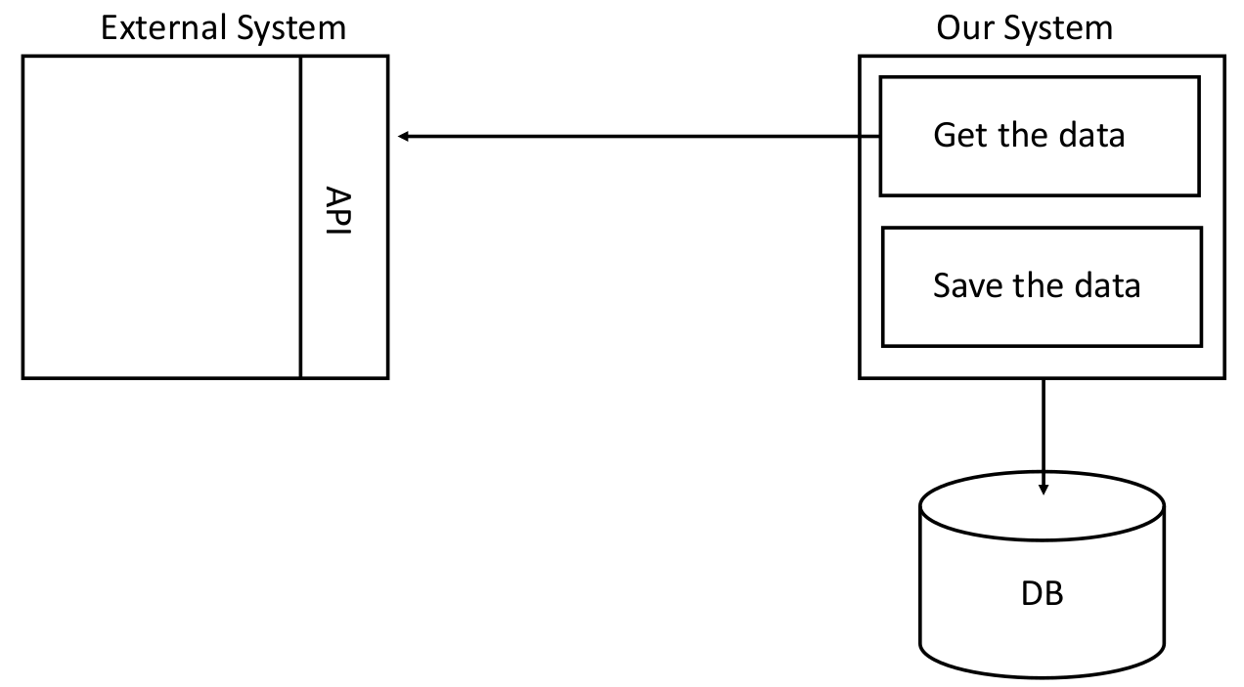
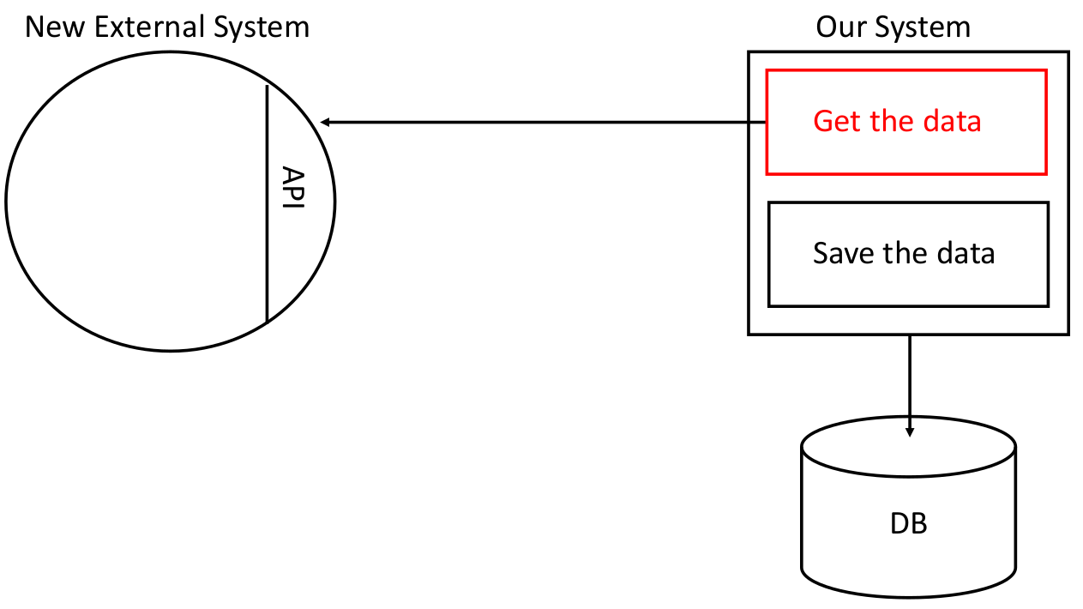
Architecture Quality Attributes
Modularity :
Modular system is built from (smaller) building blocks that can be changed or replaced or integrated without affecting the whole system.

Slide 48
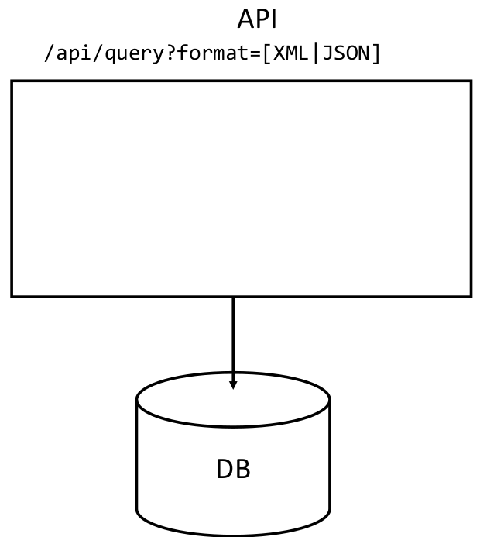
Architecture Quality Attributes
Extensibility :
The capability of a system where its functionality can be extended to add new features without modifying its existing code
Example : We have an Backend API service to generate XML and JSON (Two formats )
We need to CSV format ?

Slide 49
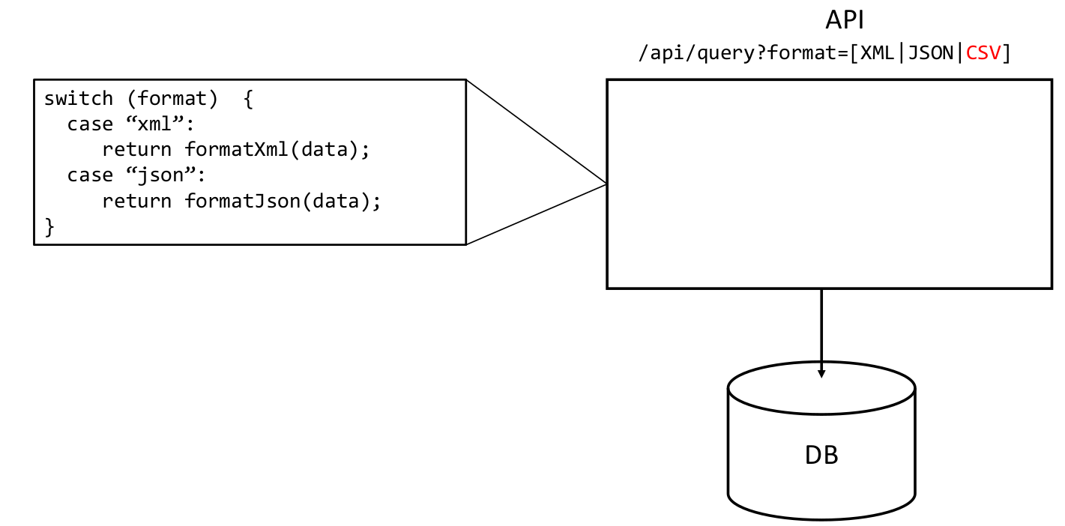
Architecture Quality Attributes
Extensibility :
The capability of a system where its functionality can be extended to add new features without modifying its existing code
Example : We have an Backend API service to generate XML and JSON
How it can be extended to add CSV ? without modifying the actual code

Slide 50
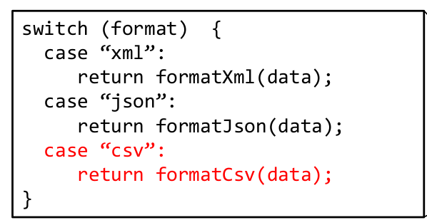
Architecture Quality Attributes
Extensibility :
The capability of a system where its functionality can be extended to add new features without modifying its existing code
Example : We have an Backend API service to generate XML and JSON
This is totally the incorrect way of doing it

Slide 51
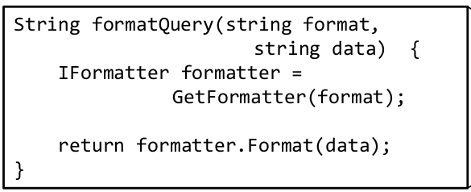
Architecture Quality Attributes
Extensibility :
The capability of a system where its functionality can be extended to add new features without modifying its existing code
Example : We have an Backend API service to generate XML and JSON
We use design patterns.

Slide 52
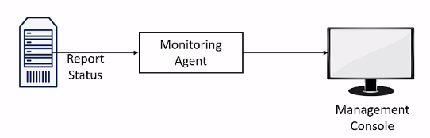
Architecture Quality Attributes
Manageability :
It is the ability to know what’s going on with the software application at any given time in order to take actions to improve its performance.
Self-reporting can help to automate the system to be manageable and improve recovery from failure or fault tolerance (To respond to failure and continue functioning normally)

Slide 53
Architecture Quality Attributes
Other qualities :
adaptability
deployability
upgradability
recoverability ….
https://en.wikipedia.org/wiki/List_of_system_quality_attributes

Slide 54
Software Architectural Styles
What’s an Architectural Style
Reusable solution, pattern or template to a commonly occurring problem in software architecture within a given context.
It facilitates the structuring of components by using a well-tested solution.
The use of terms : style vs. pattern is still debatable among software engineers.
Architecture Pattern describes reusable structural building blocks.
Architecture Style describes the overall system consisting of architectural patterns.

Slide 55
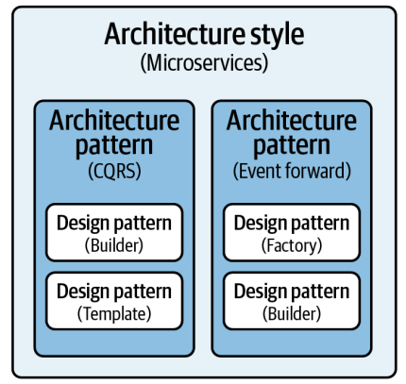
Software Architectural Styles
What’s an Architectural Style
CQRS : Command Query Responsibility Segregation.
Design Pattern : Low-level architectural design, not to be confused with architectural pattern.

Slide 56
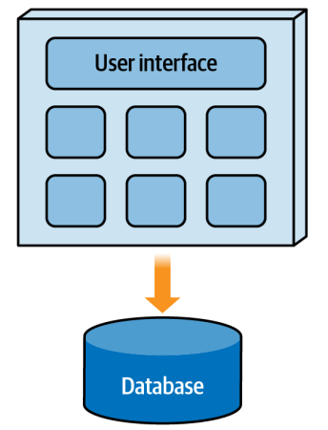
Software Architectural Styles
Architecture Classification
Monolithic Architectures :
Single deployment Unit.
Good Points :
Must easier to design and implement
Inexpensive
Deployed more quickly.
Weak Point :
Scalability ( Only Vertical )
Fault tolerance

Slide 57
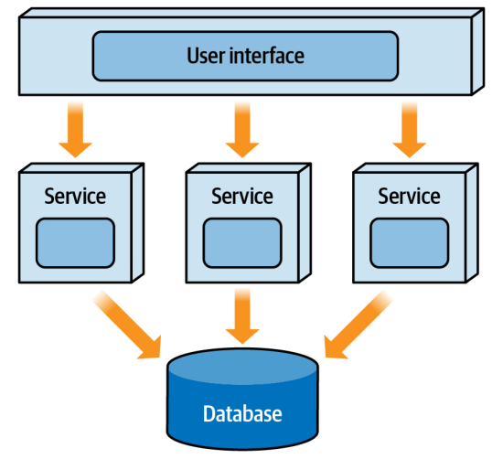
Software Architectural Styles
Architecture Classification
Distributed Architectures :
Multiple deployment Units.
Good Points :
Scalability (Up or Out)
Performance
Fault Tolerance
Weak Point :
Expensive
Maintenance
Complexity

Slide 58
Software Architectural Styles
Distributed architectures are plagued with the 8 fallacies of distributed computing :
The network is reliable
Latency is zero
Bandwidth is infinite
The network is secure
Topology doesn't change
There is one administrator
Transport cost is zero
The network is homogeneous.
Architecture Classification
Distributed Architectures :
Multiple deployment Units.
Good Points :
Scalability (Up or Out)
Performance
Fault Tolerance
Weak Point :
Expensive
Maintenance
Complexity

Slide 59
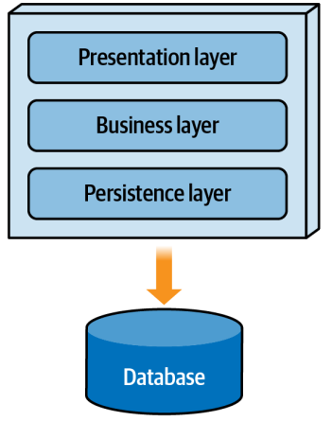
Software Architectural Styles
Architecture Partitioning
Architects can design and group functionalities into components using either:
Technical Partitioning
Domain Partitioning

Slide 60
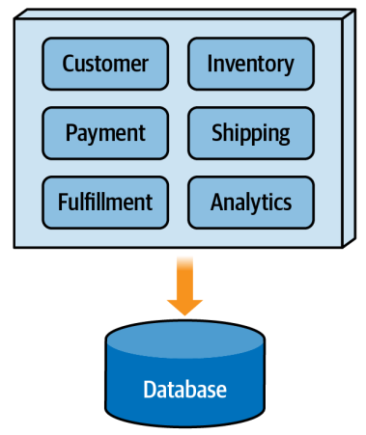
Software Architectural Styles
Architecture Partitioning
Architects can design and group functionalities into components using either:
Technical Partitioning
Domain Partitioning

Slide 61
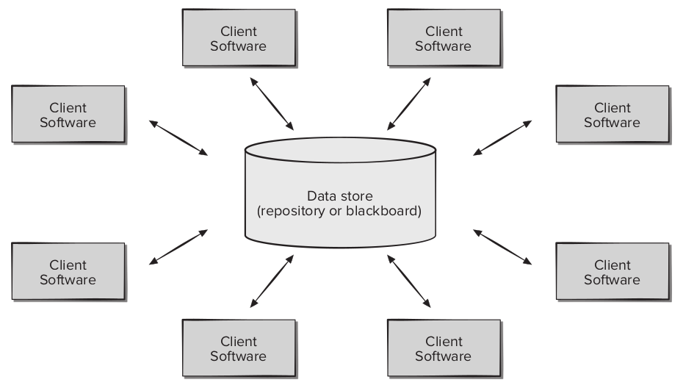
Software Architectural Styles
Data-Centred (Repository) Architecture Style
A data store (e.g., a file or database) resides at the center of this architecture and is accessed frequently by other components that update, add, delete, or otherwise modify data within the store
A component is not aware of the data or states of other components.

Slide 62
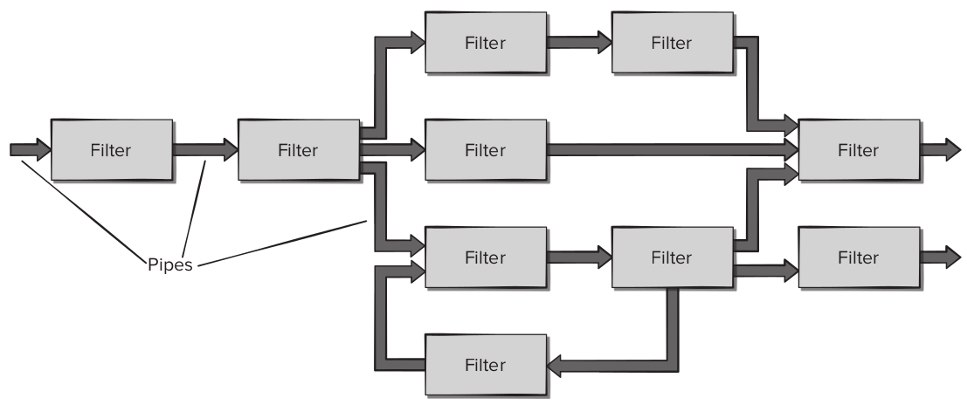
Software Architectural Styles
Pipe and Filter (Data-Flow) Architecture Style
has a set of components, called filters, connected by pipes that transmit data from one component to the next.
Each filter works independently of other components
A Filter expects data from previous Filter, does some process and produces data in a form suitable for the next filter

Slide 63
Software Architectural Styles
Model-View-Controller (MVC) Architecture Style
Composed of three components:
Model : contains all application-specific content and processing logic including access to the database.
View : contains all interface-specific functions and enables the presentation of content and processing logic required by the end user
Controller : manages access to the model and the view and coordinates the flow of data between them

Slide 64
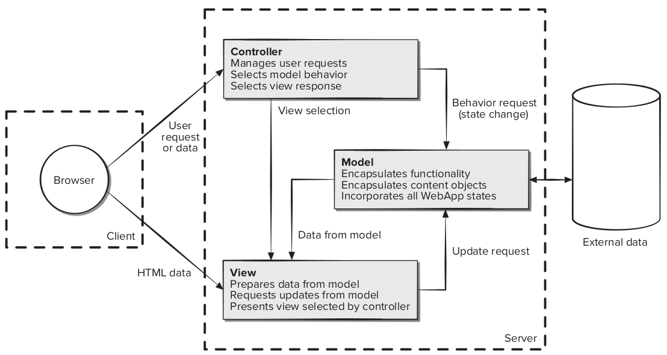
Software Architectural Styles
Model-View-Controller (MVC) Architecture Style
ss

Slide 65
Software Architectural Styles
Model-View-Controller (MVC) Architecture Style
ss
Introduced initially for Desktop-GUI Applications, but became popular among web applications where many MVC-oriented frameworks are developed

Slide 66
Software Architectural Styles
Layered Architecture Style
Also known as the “n-tier architecture” ( Debatable )
Contains a number of layers where each layer has a specific role and responsibility within the application
Examples of layers include :
Presentation : for rending the user interface
Business Logic : for computing, processing requests,..
Persistence : for loading, searching and saving to the database
database layer : for storing data into the actual DBMS

Slide 67
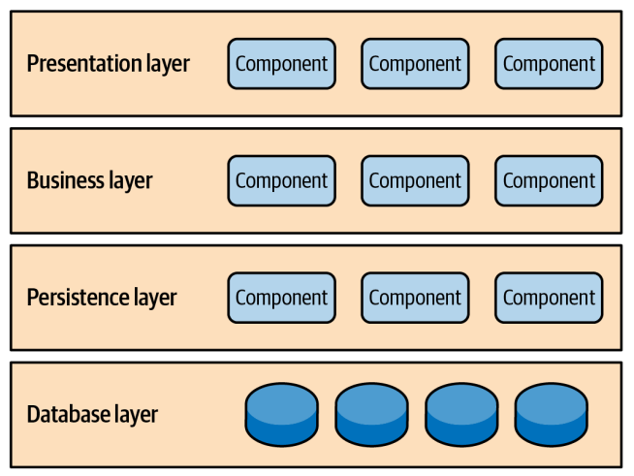
Software Architectural Styles
Layered Architecture Style
Can the presentation layer communicate directly with the database ? Faster ? Quick ? Or can the database layer updates the presentation layer directly ?

Slide 68
Software Architectural Styles
Layered Architecture Style
Architecture by default is closed layer to enforce the layers of isolation
Closed Layer: Only layer adjacent to each other can communicate. (Opposite or open Layered architecture)
Layers of isolation = “ a change made in one layer don’t impact or affect component on other layers”

Slide 69
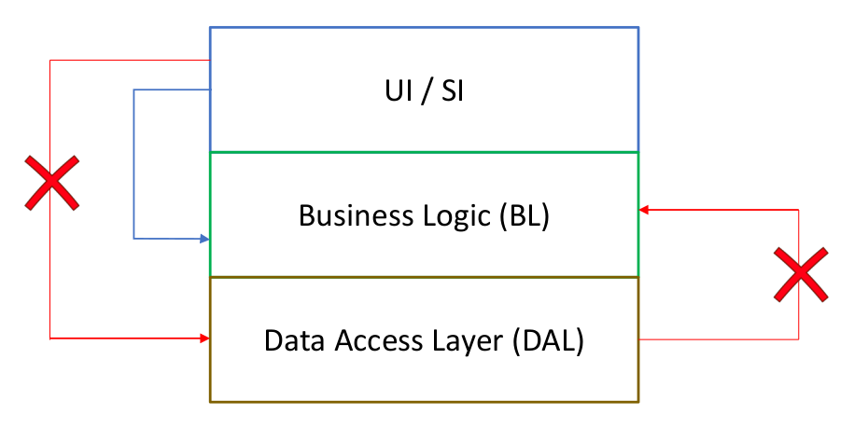
Software Architectural Styles
Layered Architecture Style
Separate the module or decouple them as much as possible.
If you change the data access layer, you won’t need to change the BL or UI.

Slide 70
Software Architectural Styles
Pay a lot of attention to the direction of the arrows, who is calling who ?
Layered Architecture Style
Separate the module or decouple them as much as possible.
If you change the data access layer, you won’t need to change the BL or UI.

Slide 71
Software Architectural Styles
Layered Architecture Style
When to use :
Time or budget constraints : It is simple ( and mostly monolithic style) and no complexity is involved. Secondly, most developers are familiar with it this style, making it easier to implement.
For the case when the changes are mostly isolated to specific layer ( Changing the business rules only, or changing the user interface).
When not to use:
Not scalable
If there are regular changes at the domain level. ( Example, add Expiration date to To-do would impact all layers)

Slide 72
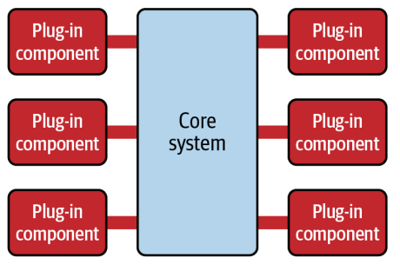
Software Architectural Styles
Microkernel Architecture Style
is a flexible and extensible architecture that allows a developer or end user to easily add additional functionality and features to an existing software system in the form of extensions, or “plug-ins,”
Also named : “plug-in architecture style”
Example :
Operating System
Chrome/ Firefox
Eclipse IDE

Slide 73
Software Architectural Styles
Microkernel Architecture Style
When to use :
Product-based application that will have heavily planned extensions
Software systems with multiple and/or custom configurations
May be we store to different services ( cloud, file system..)
May be the possibility to with different services.
When not to use:
Not scalable as core system acts the main bottleneck.
If there will be a change in the core system, it will mess all plugins

Slide 74
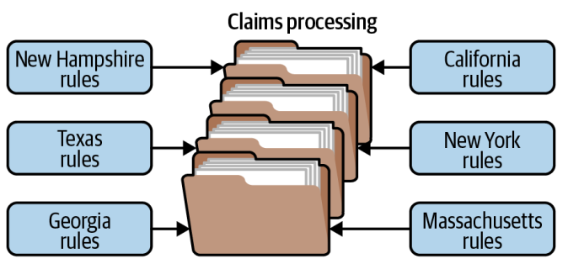
Software Architectural Styles
Microkernel Architecture Style

Slide 75
Software Architectural Styles
Microkernel Architecture Style
is a flexible and extensible architecture that allows a developer or end user to easily add additional functionality and features to an existing software system in the form of extensions, or “plug-ins,”
Also named : “plug-in architecture style”
Example :
Operating System
Chrome/ Firefox
Eclipse IDE

Slide 76
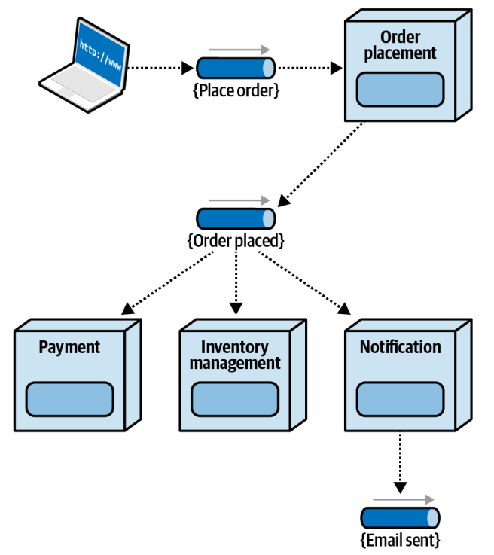
Software Architectural Styles
Event-Driven Architecture Style
Relies on asynchronous processing using highly decoupled event processors that trigger events and correspondingly respond to events happening in the system

Slide 77
Software Architectural Styles
Microservice Architecture Style
A microservice is defined as a single-purpose, separately deployed unit of software that does one thing really, really well

